Slide 1
Genes Corresponding to SM

Slide 2
CRC SM

Slide 3
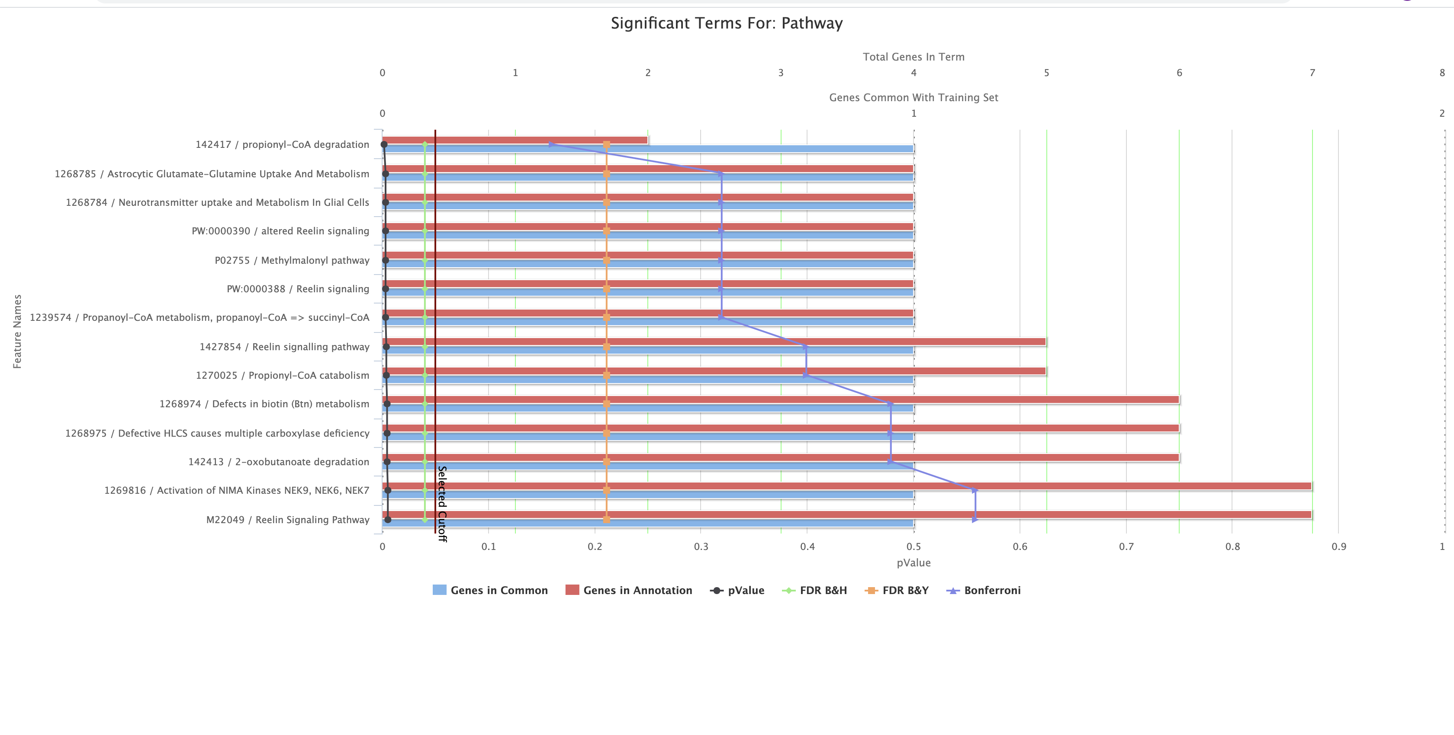
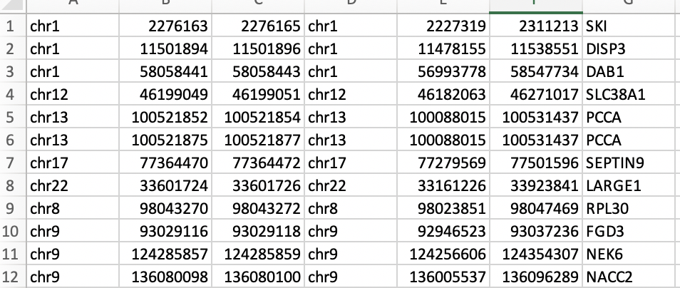
CRC_SM
PBL

Slide 4
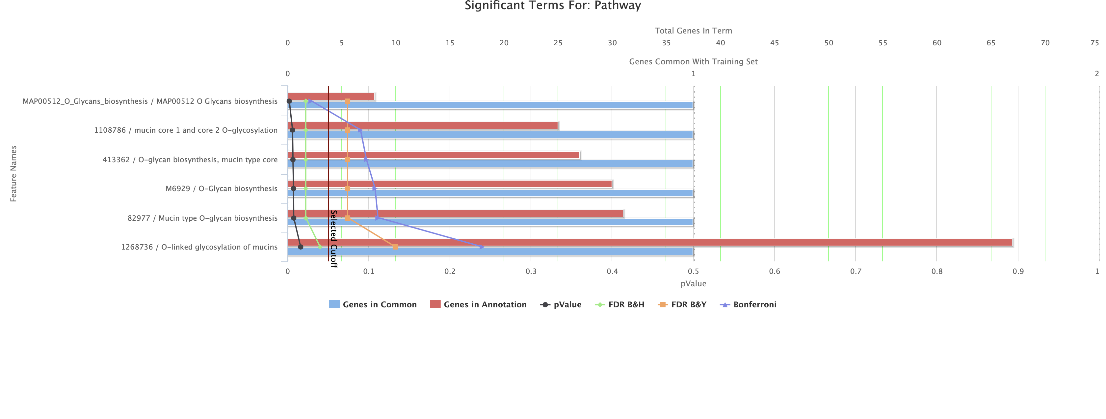
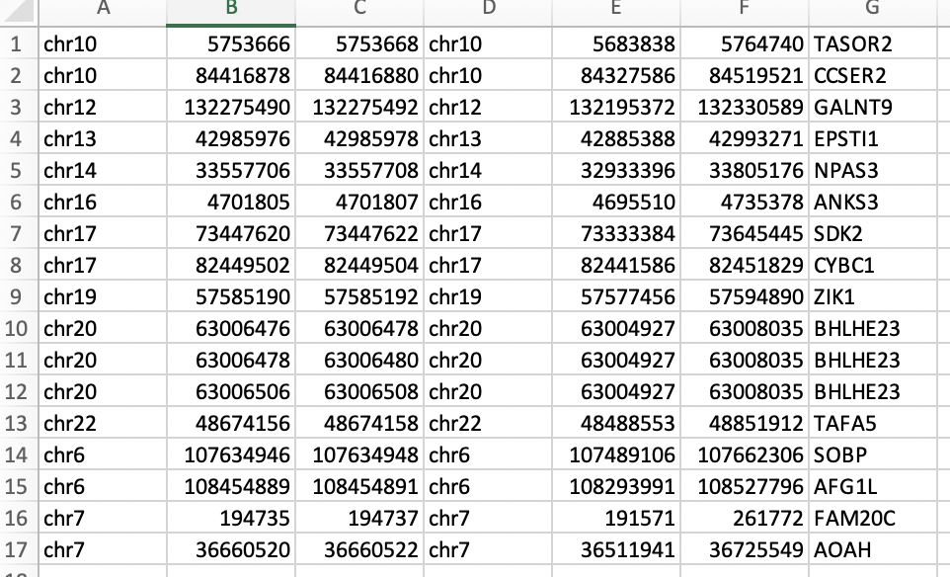
CRC_SM
EPCAM

Slide 5
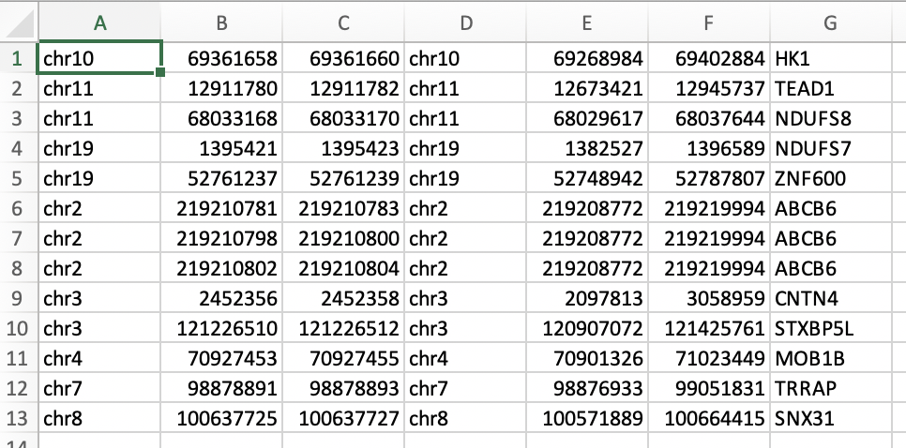
CRC_SM
TIL

Slide 6
MEL_SM

Slide 7
MEL_SM

Slide 8
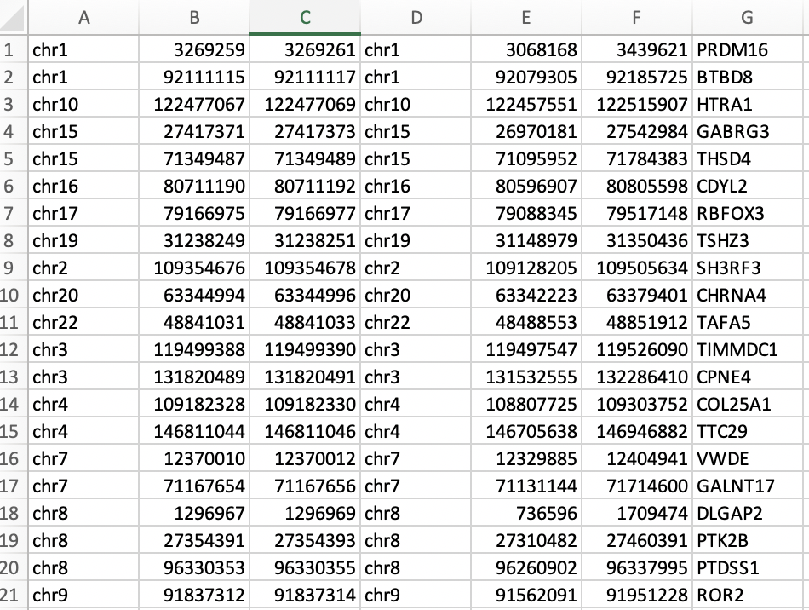
MEL_SM
FDR cutoff 0.1
PBL

Slide 9
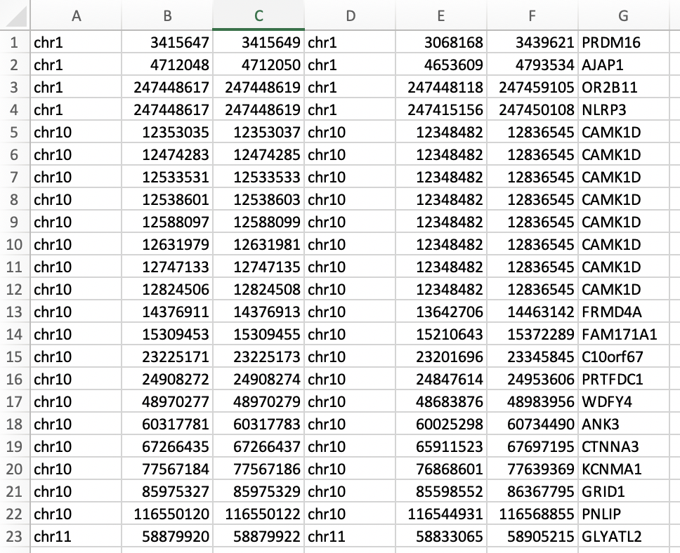
MEL_SM
FDR cutoff 0.1
Mel_Tumor

Slide 10
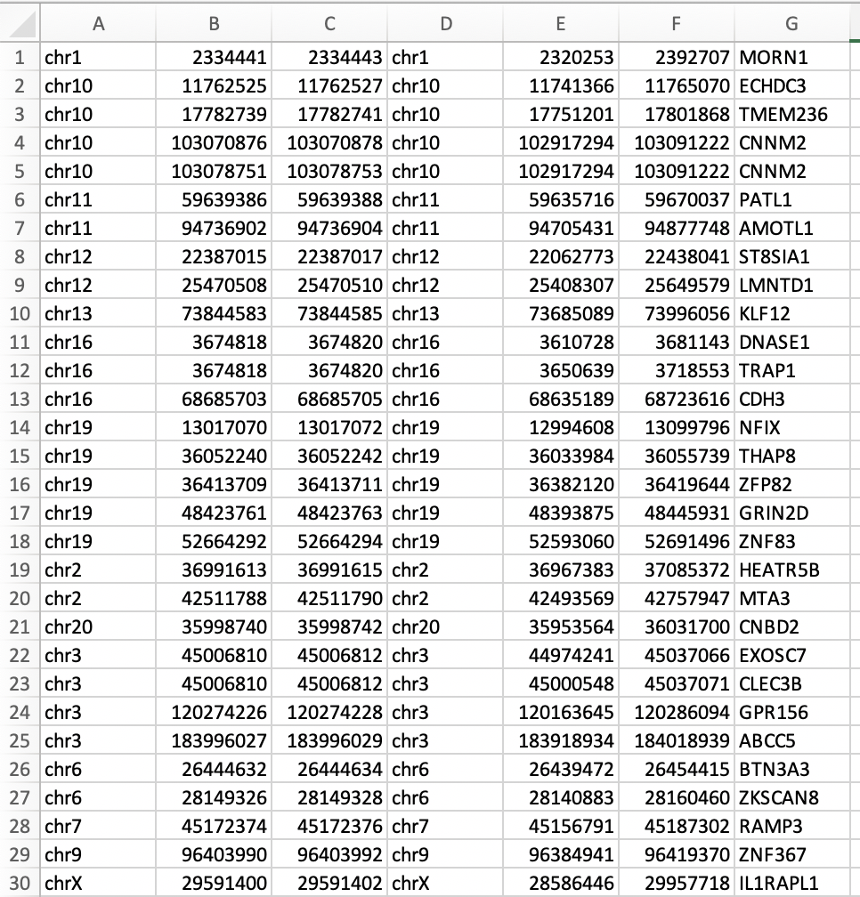
MEL_SM
FDR cutoff 0.2
TIL

Slide 11
Supp

Slide 12
Full CRC SM (FDR .2)

Slide 13
MEL_SM
FDR cutoff 0.2
Full Mel_SM

